Slide 1
Year 8 Revision
You will be having an assessment to find out what you have understood from what we have done since September.
The assessment will be completed on iPads and will include:
Questions checking your understanding of key vocabulary and ideas from Romeo and Juliet.
Questions testing your understanding of the context of John Steinbeck’s Of Mice and Men.
Questions testing your understanding of how Willy Russell communicates differences in social class in Blood Brothers.
Work through the following slides to prepare for your assessment

Slide 2
OF MICE AND MEN
Which of the following best describes The American Dream?
A. A political strategy used during the Cold War
B. The belief that America should expand its territory
C. The idea that anyone can achieve success through hard work ✅
D. A myth about the origins of the U.S. Constitution
Explanation: The American Dream is the idea that success is achievable by anyone through effort, regardless of background.

Slide 3
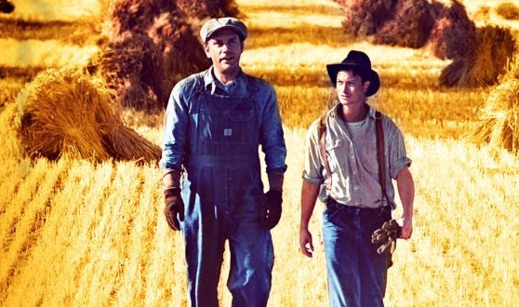
What does the term symbiotic mean in a biological context?
A. A one-sided relationship where one organism harms another
B. A random interaction between two organisms
C. A mutually beneficial relationship between two organisms ✅
D. A competition between two similar species
Explanation: In biology, a symbiotic relationship is one in which both organisms benefit from the interaction.
You can use the word symbiotic to describe a relationship between two people; George and Lennie have a symbiotic relationship.

Slide 4
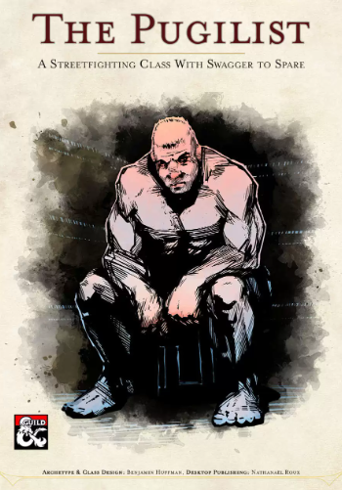
What does the word pugnacious most closely mean?
A. Generous and kind
B. Eager to fight or argue ✅
C. Lazy and unmotivated
D. Wise and thoughtful
Explanation: The word 'pugnacious' means eager or quick to argue, quarrel, or fight.

Slide 5
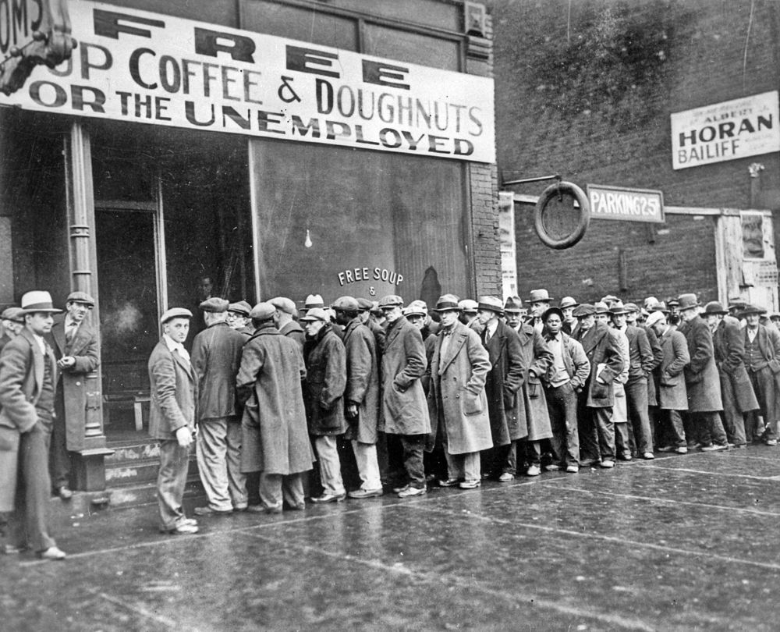
What was The Great Depression of 1929?
A. A drought that affected farmers in the Midwest
B. A period of widespread economic hardship and unemployment in the U.S. ✅
C. A political scandal involving the U.S. presidency
D. The name of a military conflict in Europe
Explanation: The Great Depression was a major economic crisis that began in 1929, leading to high unemployment and poverty.

Slide 6
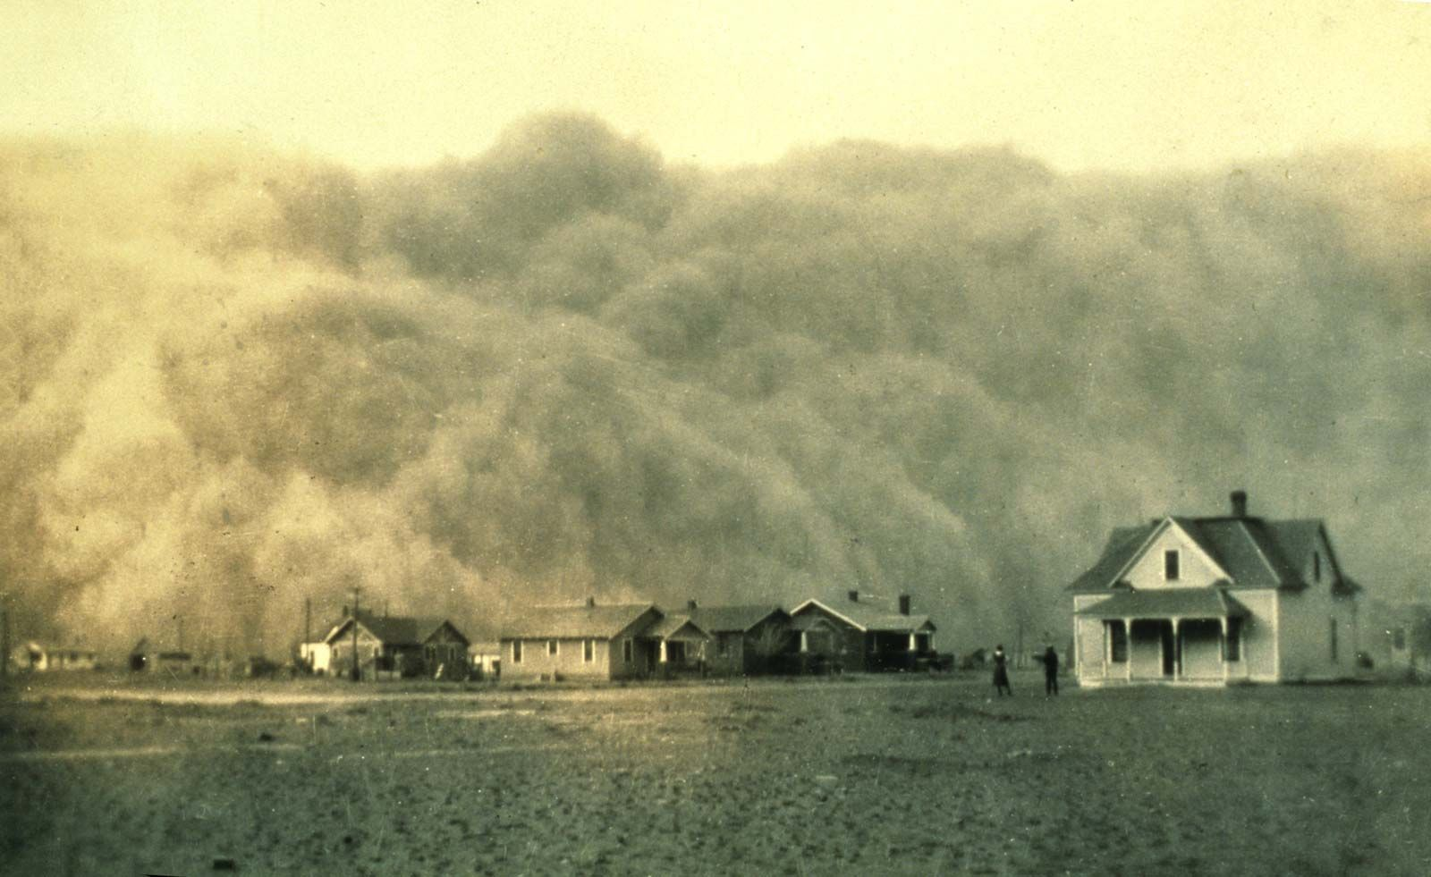
What was The Dust Bowl primarily caused by?
A. A volcanic eruption in the Midwest
B. Massive urban fires
C. Over-farming and severe drought in the 1930s ✅
D. Industrial pollution in cities
Explanation: The Dust Bowl was caused by over-farming and a lack of rain, leading to severe dust storms in the central U.S.

Slide 7
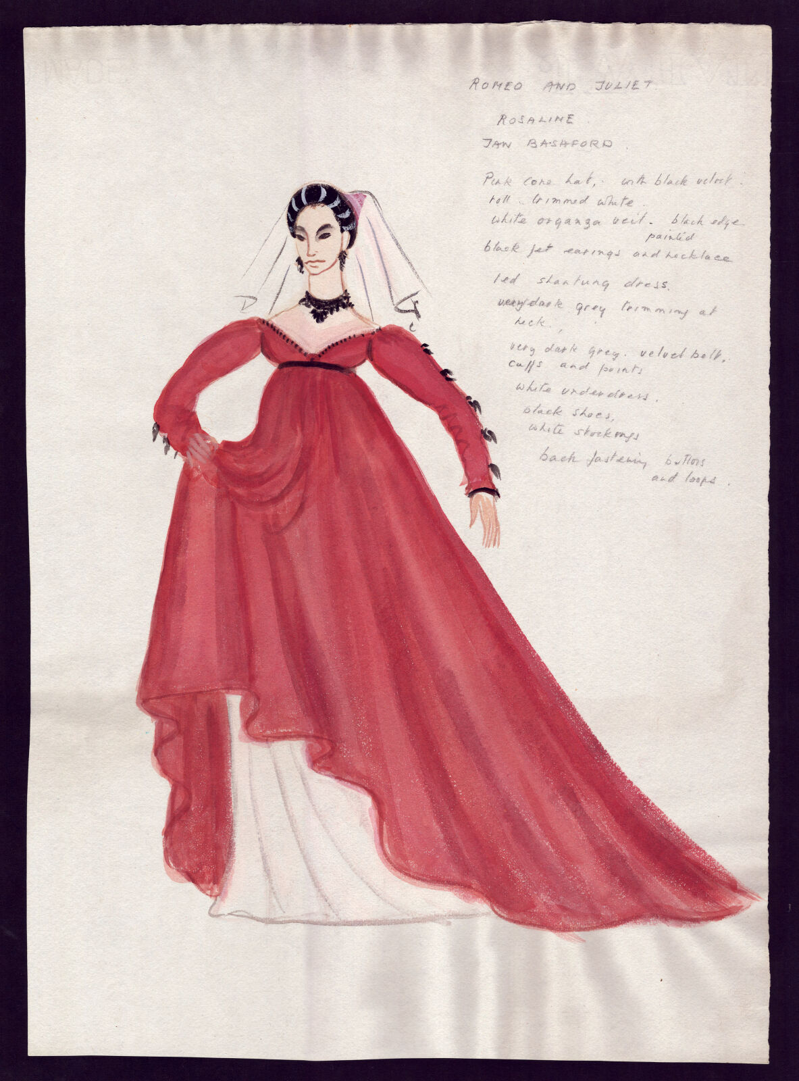
ROMEO AND JULIET
In Act 1, who is Romeo in love with before he meets Juliet?
A. Juliet
B. Rosaline ✅
C. Tybalt
D. Lady Capulet
Explanation: Romeo is heartbroken over Rosaline at the beginning of the play, before he meets Juliet at the Capulet party.

Slide 8

When Juliet says in Act 2: "What's in a name? That which we call a rose / By any other word would smell as sweet," what does she mean?
A. She wants Romeo to leave his family.
B. She believes names don’t change the worth of a person. ✅
C. She thinks Romeo is hiding something.
D. She prefers flowers to people.
Explanation: Juliet argues that Romeo’s name (Montague) is not what matters—she values him for who he is.

Slide 9
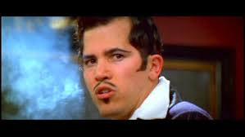
In Act 1, Tybalt becomes angry when he sees Romeo at the Capulet party. What does this tell us about Tybalt’s character?
A. He is jealous of Romeo.
B. He is shy and quiet.
C. He is quick to anger and very loyal to his family. ✅
D. He wants to make peace with the Montagues.
Explanation: Tybalt's immediate anger and hostility show his hot temper and deep loyalty to the Capulet name.

Slide 10
What literary device is used when Romeo says in Act 2: "With love’s light wings did I o’erperch these walls; / For stony limits cannot hold love out"?
A. Simile
B. Metaphor ✅
C. Personification
D. Alliteration
Explanation: Romeo compares love to having wings, suggesting love gives him power to overcome obstacles—this is a metaphor.

Slide 11
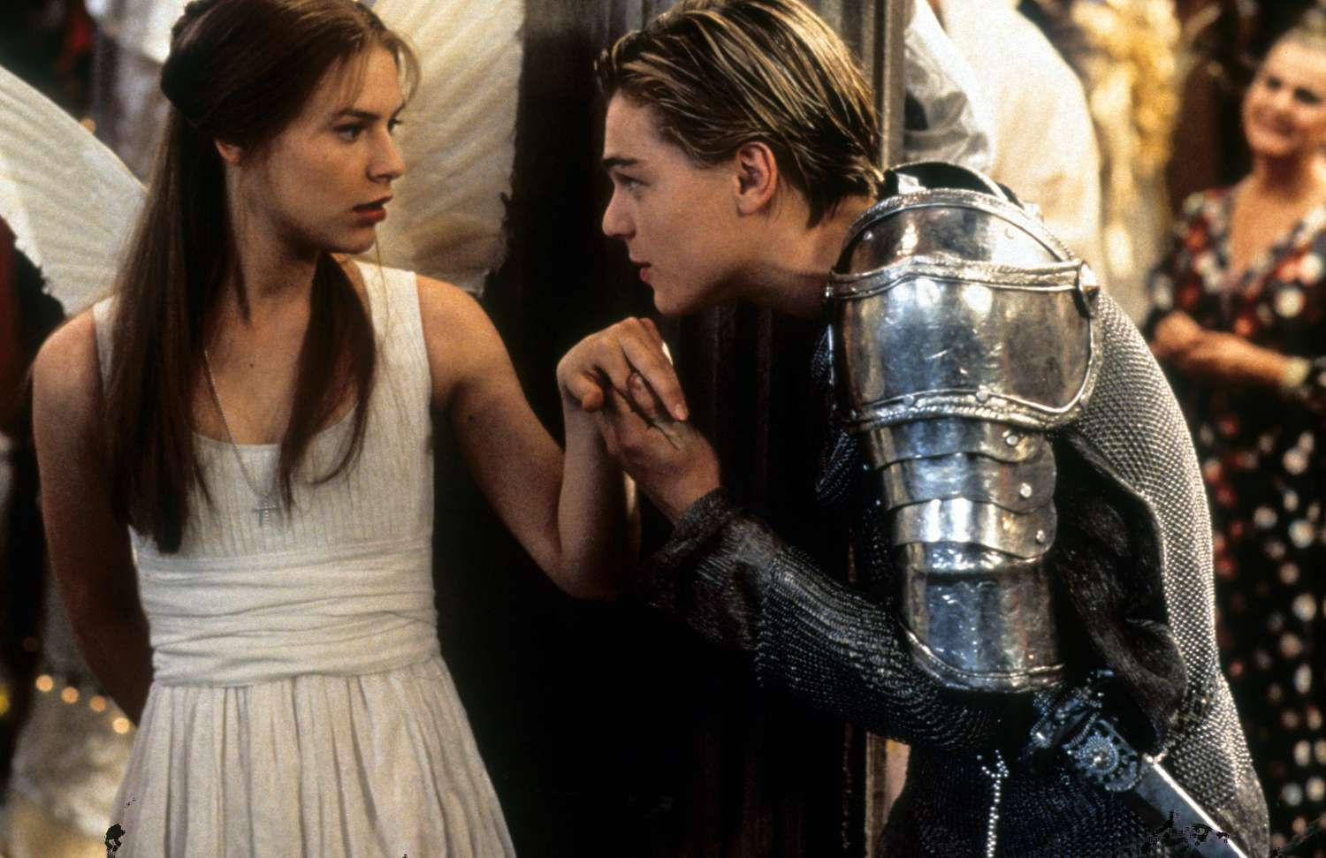
Which of the following lines from Act 1 best shows Shakespeare’s use of oxymoron to express Romeo’s feelings?
A. With love’s light wings did I o’erperch these walls.
B. What’s in a name? That which we call a rose…
C. O brawling love, O loving hate, / O anything of nothing first create! ✅
D. It is the East, and Juliet is the sun!
Explanation: Romeo uses oxymorons like 'brawling love' and 'loving hate' to show how confused and emotional he feels about love.

Slide 12
BLOOD BROTHERS
Russell uses costume and stage directions to highlight the class differences between the Johnstone and Lyons families.
A. True ✅
B. False
Explanation: The Lyons are described as neat and well-dressed, while the Johnstones wear scruffier clothes.

Slide 13
The way Mickey and Edward speak and behave when they first meet suggests that they are from the same social background.
A. True
B. False ✅
Explanation: Mickey uses slang, while Edward speaks politely—showing they come from very different backgrounds.

Slide 14

Willy Russell shows the difference in social class by giving Mrs. Johnstone a strong Liverpudlian accent and making her speak informally.
A. True ✅
B. False
Explanation: This helps show that she comes from a working-class background.

Slide 15
In Act 1, Mrs. Lyons is portrayed as warm and friendly toward Mrs. Johnstone throughout the entire act.
A. True
B. False ✅
Explanation: At first, Mrs. Lyons seems kind, but she becomes controlling and manipulative as the act goes on.

Slide 16
Blood Brothers - Short essay response (2 detailed paragraphs)
Explore how Willy Russell presents differences in social class in the dialogue below, between Edward and Mickey. (This is taken from the scene where the boys first meet).
You should write about:
- What is suggested by the use of formal and informal English?
- What is suggested about the behaviour of each boy?
How do Russell's choices create ideas about social class in 1980s Liverpool for the audience?
Write two detailed paragraphs.
EXTRACT
A
Mickey Yeh. Yeh, I know loads of words like that. Y’ know, like the ‘F’ word.
Edward (clueless) Pardon?
Mickey The ‘F’ word.
Edward is still puzzled.
Mickey looks round to check that he cannot be overheard, then whispers the word to Edward. The two of them immediately wriggle and giggle with glee.
Edward What does it mean?
Mickey I don’t know. It sounds good though, doesn’t it?
Edward Fantastic. When I get home I’ll look it up in the dictionary.
Mickey In the what?
Edward The dictionary. Don’t you know what a dictionary is?
Mickey ’Course I do… . It’s a, it’s a thingy innit?
Edward A book which explains the meaning of words.
Mickey The meaning of words, yeh. Our Sammy’ll be here soon. I hope he’s in a good mood. He’s dead mean sometimes. Edward Why? Mickey It’s ’cos he’s got a plate in his head.
Revision and practice:
Consider which quotes you would pick out from this extract.
Which words show differences in social class
between the two boys.

Slide 17
Blood Brothers - Short essay response (2 detailed paragraphs)
Explore how Willy Russell presents differences in social class in the dialogue below, between Edward and Mickey. (This is taken from the scene where the boys first meet).
You should write about:
- What is suggested by the use of formal and informal English?
- What is suggested about the behaviour of each boy?
How do Russell's choices create ideas about social class in 1980s Liverpool for the audience?
Write two detailed paragraphs.
Revision and practice:
Consider which quotes you would pick out from this extract.
Which words show differences in social class
between the two boys.
EXTRACT
A
Mickey Yeh. Yeh, I know loads of words like that. Y’ know, like the ‘F’ word.
Edward (clueless) Pardon?
Mickey The ‘F’ word.
Edward is still puzzled.
Mickey looks round to check that he cannot be overheard, then whispers the word to Edward. The two of them immediately wriggle and giggle with glee.
Edward What does it mean?
Mickey I don’t know. It sounds good though, doesn’t it?
Edward Fantastic. When I get home I’ll look it up in the dictionary.
Mickey In the what?
Edward The dictionary. Don’t you know what a dictionary is?
Mickey ’Course I do… . It’s a, it’s a thingy innit?
Edward A book which explains the meaning of words.
Mickey The meaning of words, yeh. Our Sammy’ll be here soon. I hope he’s in a good mood. He’s dead mean sometimes. Edward Why? Mickey It’s ’cos he’s got a plate in his head.
EXAMPLE RESPONSE
In this passage, Willy Russell uses the way Mickey and Edward talk to show their differences in social class.
Mickey speaks in a very casual, informal way with colloquial language like "Yeh" and "innit," which suggests he comes from a working-class background.
He also uses the "F word" without really knowing what it means, showing that he is more interested in how it sounds than in its definition. On the other hand, Edward talks more formally and even mentions looking up the word in a "dictionary," which shows he is more educated and probably comes from a middle-class background. When Mickey doesn't understand what a dictionary is and calls it a "thingy," it highlights how he doesn't have the same level of education or understanding as Edward. This difference in their speech helps show the gap between the working class in Liverpool and the more affluent middle classes, whose lives were more comfortable.

Slide 18
Blood Brothers - Short essay response (2 detailed paragraphs)
Explore how Willy Russell presents differences in social class in the dialogue below, between Edward and Mickey. (This is taken from the scene where the boys first meet).
You should write about:
- What is suggested by the use of formal and informal English?
- What is suggested about the behaviour of each boy?
How do Russell's choices create ideas about social class in 1980s Liverpool for the audience?
Write two detailed paragraphs.
EXTRACT
B
Blood Brothers - Short essay response (2 detailed paragraphs)
Edward: Yes. Are you going to come and play up there again?
Mickey: No. I would do but I’m not allowed.
Edward: Why?
Mickey: ’Cos me mam says.
Edward: Well, my mummy doesn’t allow me to play down here actually.
Mickey: ’Gis a sweet.
Edward: All right. (He offers a bag from his pocket.)
Mickey: ‘If our Sammy gives y’ a sweet he’s usually weed on it first.
Edward: (exploding in giggles) Oh, that sounds like super fun.
Mickey: It is. If y’ our Sammy.
Edward: Do you want to come and play?
Mickey: I might do. But I’m not playin’ now ’cos I’m pissed off.
Edward: (awed) Pissed off. You say smashing things don’t you?

Slide 19
Blood Brothers - Short essay response (2 detailed paragraphs)
Explore how Willy Russell presents differences in social class in the dialogue below, between Edward and Mickey. (This is taken from the scene where the boys first meet).
You should write about:
- What is suggested by the use of formal and informal English?
- What is suggested about the behaviour of each boy?
How do Russell's choices create ideas about social class in 1980s Liverpool for the audience?
Write two detailed paragraphs.
EXTRACT
B
The use of the words ‘mam’ and ‘mummy’ show the differences in background – Mickey uses colloquial speech, shorter words and shorter sentences, suggesting a lower level of education, whereas Edward speaks in complete sentences, using more correct grammar.
Blood Brothers - Short essay response (2 detailed paragraphs)
Edward: Yes. Are you going to come and play up there again?
Mickey: No. I would do but I’m not allowed.
Edward: Why?
Mickey: ’Cos me mam says.
Edward: Well, my mummy doesn’t allow me to play down here actually.
Mickey: ’Gis a sweet.
Edward: All right. (He offers a bag from his pocket.)
Mickey: ‘If our Sammy gives y’ a sweet he’s usually weed on it first.
Edward: (exploding in giggles) Oh, that sounds like super fun.
Mickey: It is. If y’ our Sammy.
Edward: Do you want to come and play?
Mickey: I might do. But I’m not playin’ now ’cos I’m pissed off.
Edward: (awed) Pissed off. You say smashing things don’t you?

Slide 20
Blood Brothers - Short essay response (2 detailed paragraphs)
Explore how Willy Russell presents differences in social class in the dialogue below, between Edward and Mickey. (This is taken from the scene where the boys first meet).
You should write about:
- What is suggested by the use of formal and informal English?
- What is suggested about the behaviour of each boy?
How do Russell's choices create ideas about social class in 1980s Liverpool for the audience?
Write two detailed paragraphs.
EXTRACT
B
Blood Brothers - Short essay response (2 detailed paragraphs)
Edward: Yes. Are you going to come and play up there again?
Mickey: No. I would do but I’m not allowed.
Edward: Why?
Mickey: ’Cos me mam says.
Edward: Well, my mummy doesn’t allow me to play down here actually.
Mickey: ’Gis a sweet.
Edward: All right. (He offers a bag from his pocket.)
Mickey: ‘If our Sammy gives y’ a sweet he’s usually weed on it first.
Edward: (exploding in giggles) Oh, that sounds like super fun.
Mickey: It is. If y’ our Sammy.
Edward: Do you want to come and play?
Mickey: I might do. But I’m not playin’ now ’cos I’m pissed off.
Edward: (awed) Pissed off. You say smashing things don’t you?
The behaviour of Sammy’s siblings suggest that they have less supervision and guidance from parents than Edward does. This links to the challenges faced by the working class, who earn less and therefore tend to be away from the home for longer.

Slide 21
Blood Brothers - Short essay response (2 detailed paragraphs)
Explore how Willy Russell presents differences in social class in the dialogue below, between Edward and Mickey. (This is taken from the scene where the boys first meet).
You should write about:
- What is suggested by the use of formal and informal English?
- What is suggested about the behaviour of each boy?
How do Russell's choices create ideas about social class in 1980s Liverpool for the audience?
Write two detailed paragraphs.
EXTRACT
B
Blood Brothers - Short essay response (2 detailed paragraphs)
Edward: Yes. Are you going to come and play up there again?
Mickey: No. I would do but I’m not allowed.
Edward: Why?
Mickey: ’Cos me mam says.
Edward: Well, my mummy doesn’t allow me to play down here actually.
Mickey: ’Gis a sweet.
Edward: All right. (He offers a bag from his pocket.)
Mickey: ‘If our Sammy gives y’ a sweet he’s usually weed on it first.
Edward: (exploding in giggles) Oh, that sounds like super fun.
Mickey: It is. If y’ our Sammy.
Edward: Do you want to come and play?
Mickey: I might do. But I’m not playin’ now ’cos I’m pissed off.
Edward: (awed) Pissed off. You say smashing things don’t you?
Mickey uses offensive language and swearwords. This could indicate many things, for example:
1. He is exposed to more stressful situations.
2. He is exposed to the inappropriate language of adults outside his family.
3. He does not have the level of education to help him express himself without swearing.

Slide 22
Blood Brothers - Short essay response (2 detailed paragraphs)
Explore how Willy Russell presents differences in social class in the dialogue below, between Edward and Mickey. (This is taken from the scene where the boys first meet).
You should write about:
- What is suggested by the use of formal and informal English?
- What is suggested about the behaviour of each boy?
How do Russell's choices create ideas about social class in 1980s Liverpool for the audience?
Write two detailed paragraphs.
EXTRACT
B
Blood Brothers - Short essay response (2 detailed paragraphs)
Edward: Yes. Are you going to come and play up there again?
Mickey: No. I would do but I’m not allowed.
Edward: Why?
Mickey: ’Cos me mam says.
Edward: Well, my mummy doesn’t allow me to play down here actually.
Mickey: ’Gis a sweet.
Edward: All right. (He offers a bag from his pocket.)
Mickey: ‘If our Sammy gives y’ a sweet he’s usually weed on it first.
Edward: (exploding in giggles) Oh, that sounds like super fun.
Mickey: It is. If y’ our Sammy.
Edward: Do you want to come and play?
Mickey: I might do. But I’m not playin’ now ’cos I’m pissed off.
Edward: (awed) Pissed off. You say smashing things don’t you?
Edward uses words and phrases associated with middle class and upper-middle class British people: smashing, mummy, super.
These positive words indicate that Edward enjoys a more comfortable and privileged life than Mickey, whose words tend to me more negative or conflict-related (not allowed, not playin’, pissed off).

Slide 23
Blood Brothers - Short essay response (2 detailed paragraphs)
Explore how Willy Russell presents differences in social class in the dialogue below, between Edward and Mickey. (This is taken from the scene where the boys first meet).
You should write about:
- What is suggested by the use of formal and informal English?
- What is suggested about the behaviour of each boy?
How do Russell's choices create ideas about social class in 1980s Liverpool for the audience?
Write two detailed paragraphs.
EXTRACT
B
EXAMPLE RESPONSE
In this passage, Willy Russell uses the dialogue between Edward and Mickey to highlight the differences in their social class and upbringing. Mickey’s speech is informal, using colloquialisms like “’Gis a sweet” and “pissed off,” which reflects a working-class background where informal language and direct expressions are common.
His casual attitude towards things like his mother's rules ("’Cos me mam says") also shows that he is used to a more relaxed or even rebellious family environment. On the other hand, Edward speaks more formally, referring to his mother as “my mummy” and using polite phrases like “All right” when offering a sweet. This suggests he comes from a more middle-class family, but that he does not have the same maturity as Mickey. It could also suggest that he is more likely to conform to his parents expectations of politeness and good behaviour.
The contrast in their speech shows how they come from different social backgrounds, with Mickey's language reflecting a more working-class lifestyle and Edward's speech indicating a more educated, middle-class upbringing – an issue that Willy Russell wanted to convey in his play.
Blood Brothers - Short essay response (2 detailed paragraphs)
Edward: Yes. Are you going to come and play up there again?
Mickey: No. I would do but I’m not allowed.
Edward: Why?
Mickey: ’Cos me mam says.
Edward: Well, my mummy doesn’t allow me to play down here actually.
Mickey: ’Gis a sweet.
Edward: All right. (He offers a bag from his pocket.)
Mickey: ‘If our Sammy gives y’ a sweet he’s usually weed on it first.
Edward: (exploding in giggles) Oh, that sounds like super fun.
Mickey: It is. If y’ our Sammy.
Edward: Do you want to come and play?
Mickey: I might do. But I’m not playin’ now ’cos I’m pissed off.
Edward: (awed) Pissed off. You say smashing things don’t you?

